Slide 1


David Hoff
Maria Paiewonsky
Institute for Community Inclusion
University of Massachusetts, Boston www.communityinclusion.org
Students with Disabilities: Legal & Practical Issues

Slide 2

Part 1 of a
3-Part Webinar
Series
Students with Disabilities:
Legal and Practical Issues
Disability Overview and Etiquette
(January 7th - 3:00 to 4:15)
Universal Design
(January 22nd - 3:00 to 4:15)

Slide 3

Discussion
What issues have you encountered regarding students with disabilities?
What questions do you have regarding meeting the needs of students with disabilities?

Slide 4
Legal protections for students with disabilities
Americans with Disabilities Act (ADA):
applies to any program receiving state or local funds
Section 504 of the Rehabilitation Act:
applies to any program receiving federal funds
Requirements are virtually
the same under both

Slide 5

Purpose of the ADA
Guarantee civil rights of people with disabilities
by prohibiting discrimination in
  Employment (Title I)
  Public services (Title II)
  Transportation (Title II & III)
  Public accommodations (Title III)
  Telecommunications (Title IV)

Slide 6
A physical or mental impairment that substantially limits one or more major life activities
A record of such an impairment
Being regarded as having such an impairment, even when no limitations exist
Disability
as defined by the ADA

Slide 7
“MAJOR LIFE ACTIVITY”
AS DEFINED BY THE ADA
ANYTHING AN AVERAGE PERSON CAN DO WITH LITTLE OR NO DIFFICULTY, SUCH AS:
SEE
SPEAK
WALK
TALK
EAT
SLEEP
BREATHE
HEAR
LEARN
THINK
READ
CONCENTRATE
WORK
PERFORM
MANUAL TASKS
LIFT
BEND
WALK
STAND
Expanded under ADA Amendments Act of 2008

Slide 8
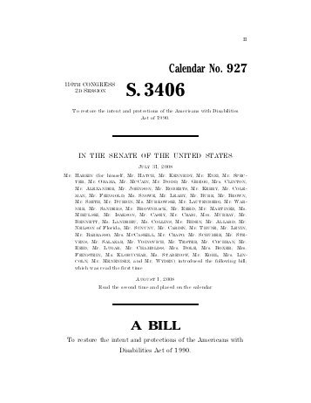
“Major Life Activity” also includes
“operation of major bodily functions” such as:
Per ADA Amendments Act of 2008
Neurological
Brain
Respiratory
Circulatory
Reproductive
Immune system

Slide 9

Definition of Disability:
Broad, Not Narrow
ADA Amendments Act of 2008:
narrow definition of disability not permitted
Definition of disability to be viewed in favor of broad coverage of individuals, to the maximum extent permitted by the ADA

Slide 10

ADA
General Theme
Changes, modifications, and accommodations must be made unless they will prove to prove to be too difficult due to impact or cost

Slide 11

ADA: TITLE II
Public Services
Requires reasonable modifications in policies, practices, and procedures to provide accessibility unless fundamental alteration in program would result
Must furnish auxiliary aids and services to ensure effective communication, unless undue burden or fundamental alteration would result
No special charges

Slide 12


ADA: TITLE III
Public Accommodation
Applies to broad range of entities engaged in private commerce including private education programs
Existing facilities must remove architectural barriers to make goods and services usable by people with disabilities,
to the extent that it is readily achievable
New construction and alterations of existing facilities must comply with ADA Accessibility Guidelines

Slide 13

What is accessible?
An individual with a disability is allowed to:
  receive same information
  participate in same interactions
  have same services
as a person without a disability
Participation is carried out in equal and integrative ways

Slide 14
Reasonable Accommodations
Any adjustment or altering of a task, process, or environment that will allow equal participation for individuals with disabilities
Must be provided to a qualified individual with a disability unless program can demonstrate that the accommodation would impose an ”undue hardship” or substantially alter nature of the program

Slide 15


Slide 16

Legal Requirements for People with Disabilities:
Applying Them to Adult Education Programs

Slide 17
Implications for Adult Education Programs
May not discriminate against individuals with disabilities regarding:
  Eligibility and admission
  Providing instruction and other services
Must be both proactive and reactive
  PROACTIVE: Programs must be accessible and barrier free
  REACTIVE: Must offer reasonable accommodations that will assist individuals with disabilities to have an equal opportunity to participate

Slide 18



Requirements for accessibility and reasonable accommodations
All program components: application and intake process, courses, examinations, physical space

Slide 19

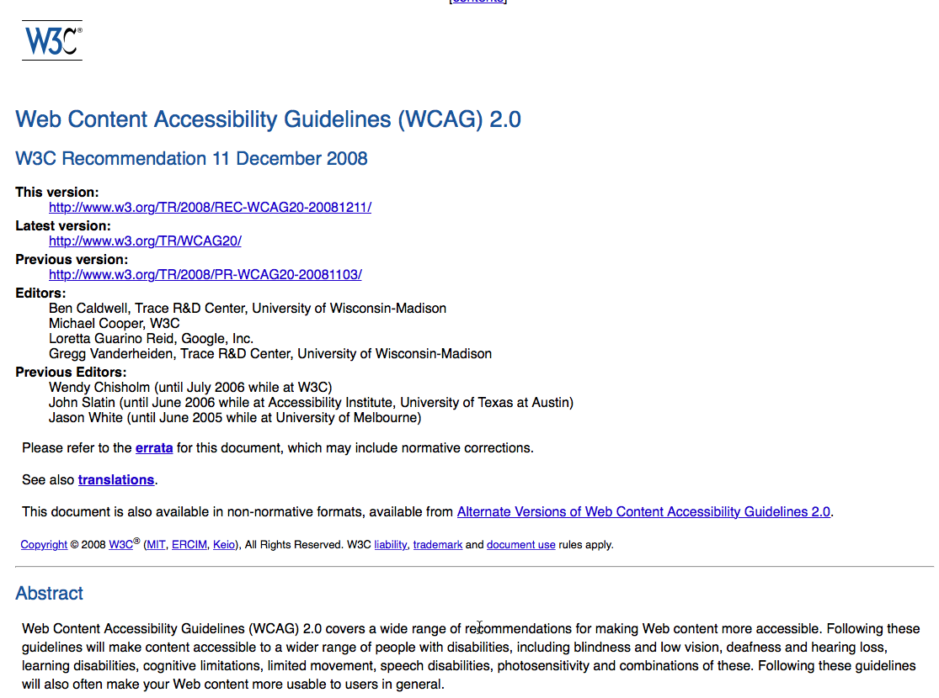
Don’t Forget About
Web Accessibility and Online Learning

Slide 20
Does this mean lowering standards and requirements?
NO!

Slide 21

Adult Learning Programs have right to:
Identify and establish abilities, skills and competencies fundamental to academic programs and courses.
Evaluate learner capacity.
Evaluate each learner’s performance on basis of standards established.

Slide 22


Disclosure and Privacy
Disability information must be kept confidential and stored separately
Information cannot be shared with anyone (internally and externally) unless specifically designated in a signed release
Programs cannot ask whether an individual has a disability prior to admission
However, if individual needs an accommodation, they need to disclose

Slide 23
After enrollment, inquiries on a confidential basis may be made with goal of determining need for possible program accommodations
Possible questions:
  Have you ever had any special classes or help in school or at work? (If “yes” you may ask what, where, and why.)
  Do you think you have trouble learning?
  Have you ever had any accommodations in school or at work?

Slide 24

Screening for Disability
If it is determined there is strong possibility learner has a disability, formal disability assessment may be undertaken
Formal assessment must be administered by a licensed professional

Slide 25

ADA Standards for Adult and Community Learning Services
Must have an ADA Coordinator
Post public notice of
non-discrimination
Establish and publish a written grievance procedure
Must conduct a one-time self-evaluation on accessibility
Must have a transition plan for removal of any physical barriers

Slide 26


Slide 27

Reasonable Accommodations in Adult Education

Slide 28
Dealing with accommodation requests
Contact ADA coordinator
Discuss in private
Use a functional approach:
    What does the student need help with?
    What are possible solutions?
    What has student previously used for accommodations in similar situations?
Document using a standard format
Don’t presume
Consult with external resources as necessary
Evaluate and modify accommodation as necessary

Slide 29

If needing an accommodation:
  Identifying themselves as having a disability
  Providing documentation regarding their disability and need for accommodation
  Requesting accommodation in a timely fashion

Slide 30

Accommodation Examples
Extra time on tests
Closed caption videos
Supervised breaks during testing
Administering tests verbally instead of in writing
Materials in alternative formats: Large print, Braille, etc.
Providing note takers
Books on tape
Assisted listening devices
Assistive technology (low-tech and hi-tech): highlighter,
calculator, accessible computer, phone apps

Slide 31
USDOJ:
Test Accommodation Guidelines
Must ensure that test scores of individuals with disabilities accurately reflect individual’s aptitude or achievement level or whatever skill the exam or test is intended to measure.

Slide 32

Student is not entitled to preferred accommodation, only an accommodation that provides equal access
EXAMPLE: Student says they need a sign language interpreter.
  What is student requesting in terms of need?
  What are possible alternatives?

Slide 33


Slide 34
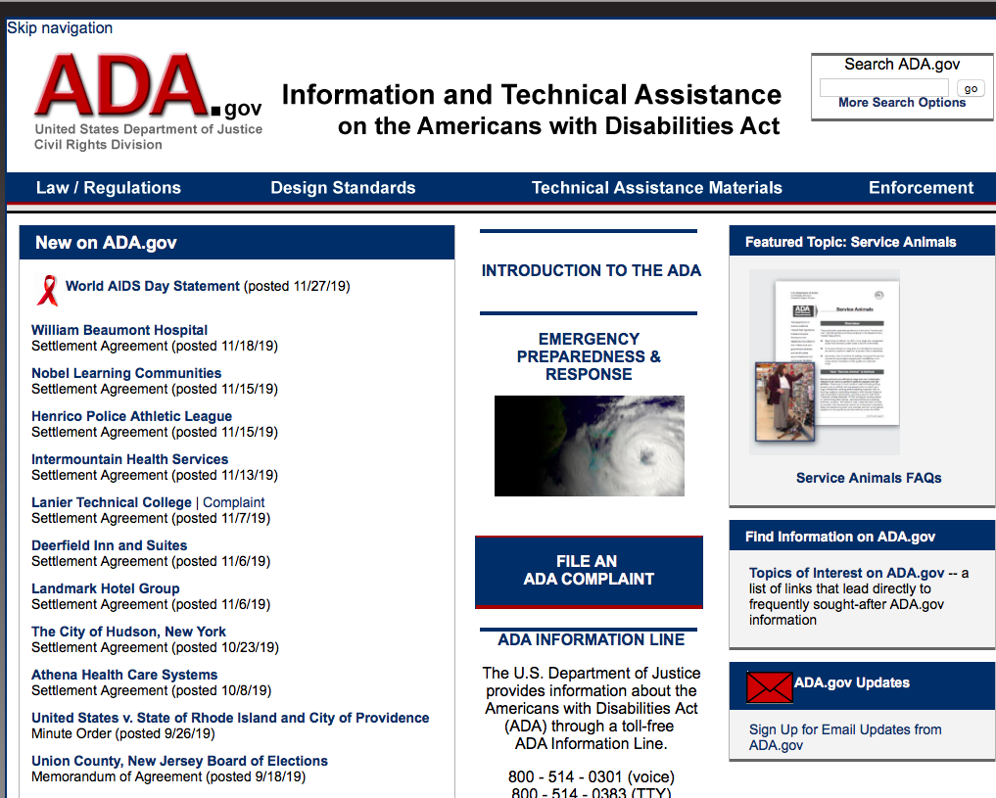
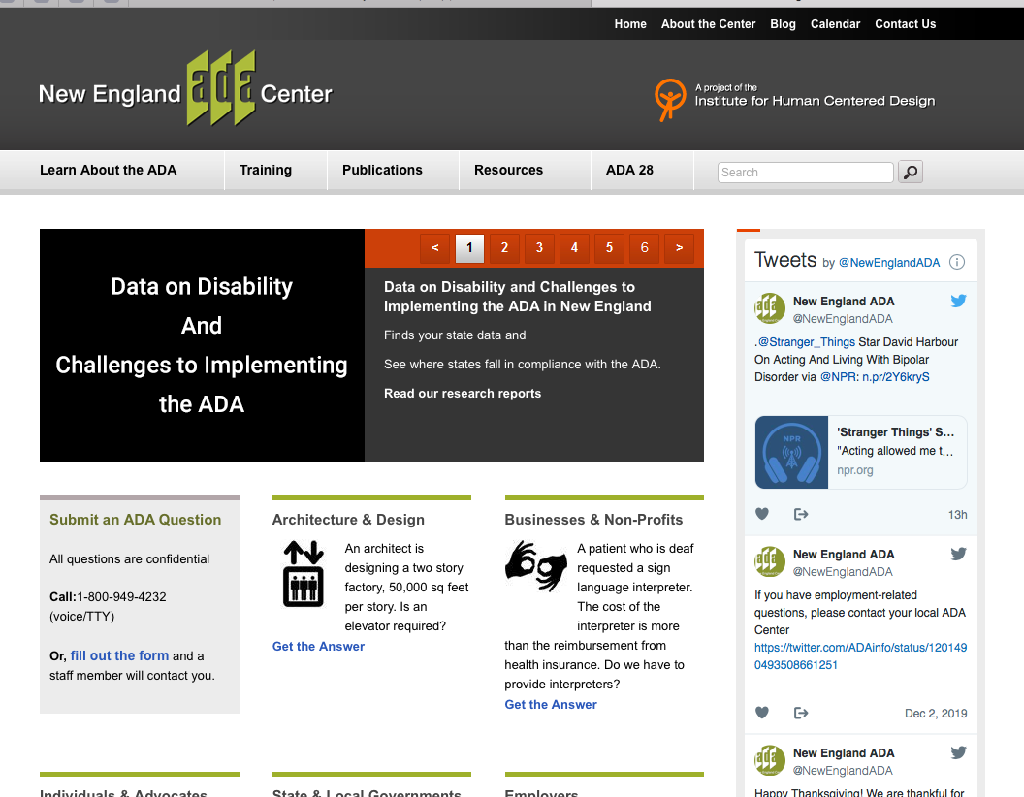
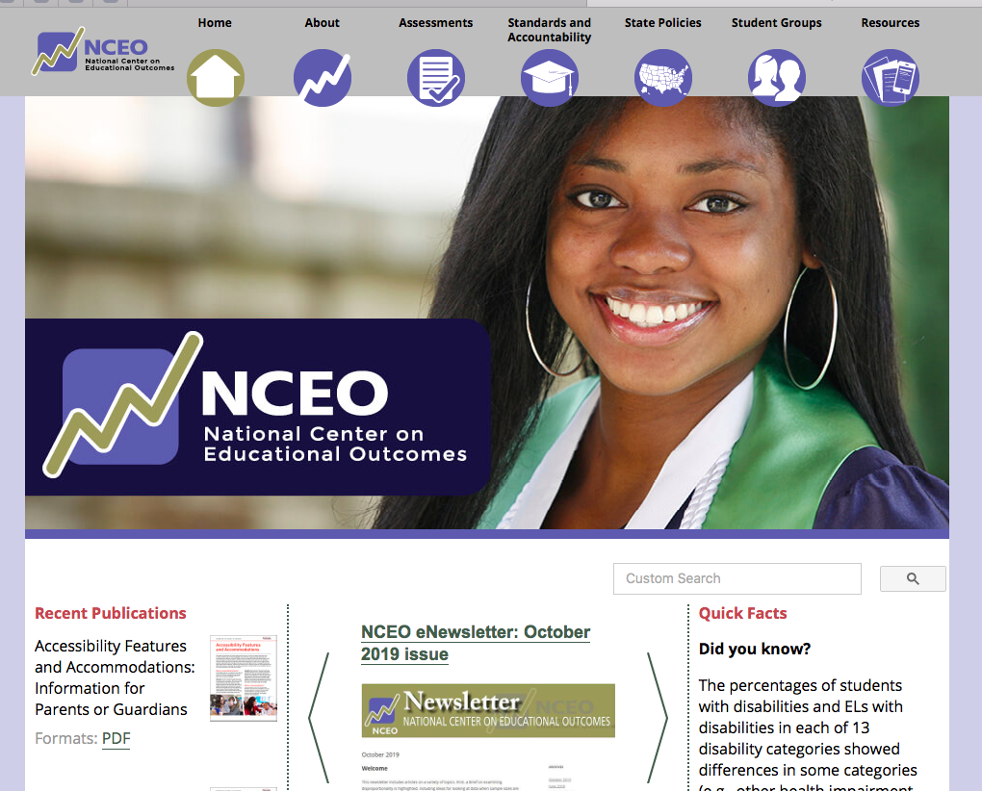
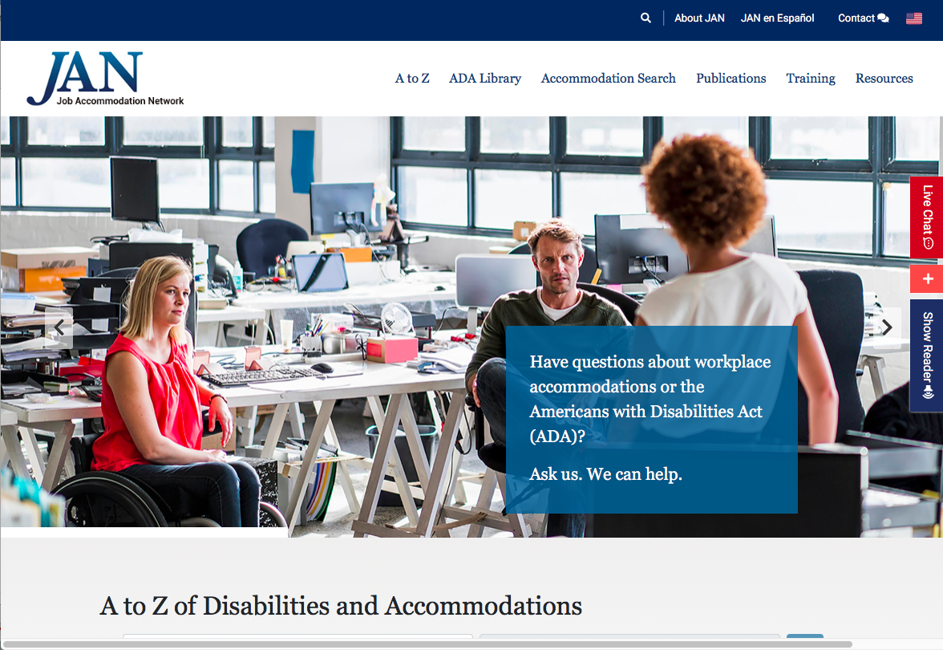
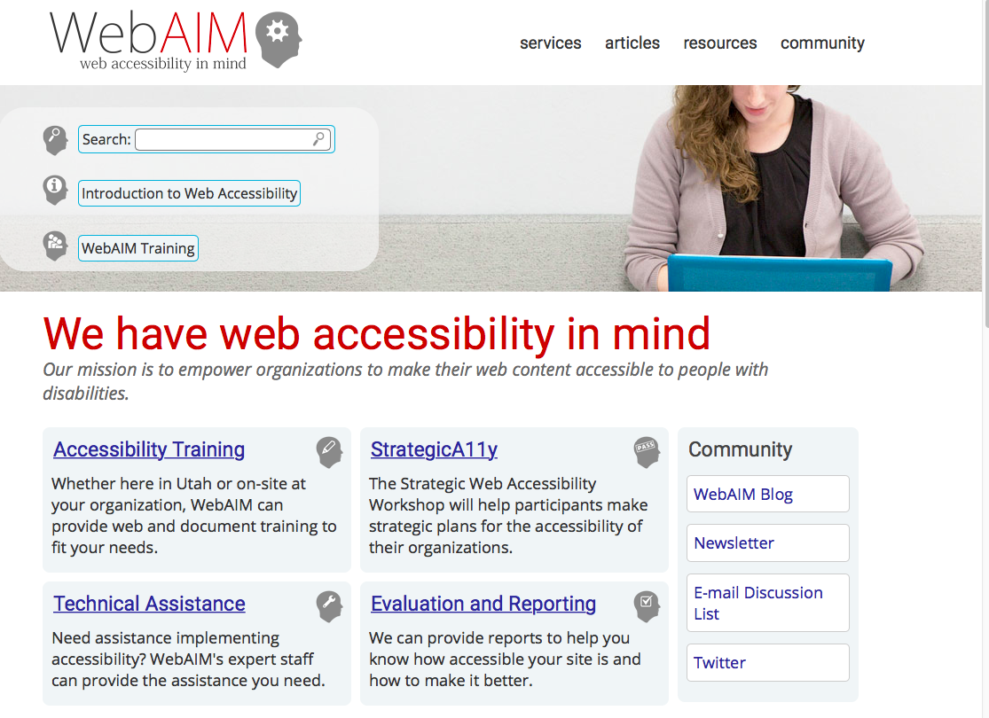
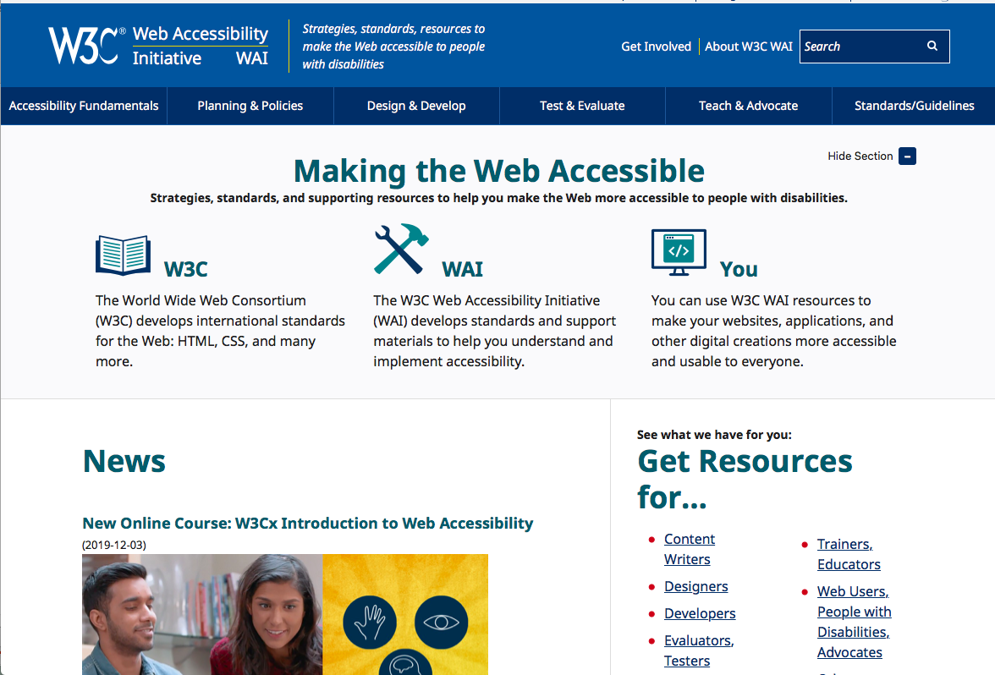
Resources

Slide 35
Handouts
PowerPoint
Disability Resources
DESE Assessment Polices
on Disability
DESE ACLS ADA Standards
USDOJ ADA Requirements:
Testing Accommodations
IL Accessibility Checklist
Pacer Handout: ADA & Section 504

Slide 36



Slide 37
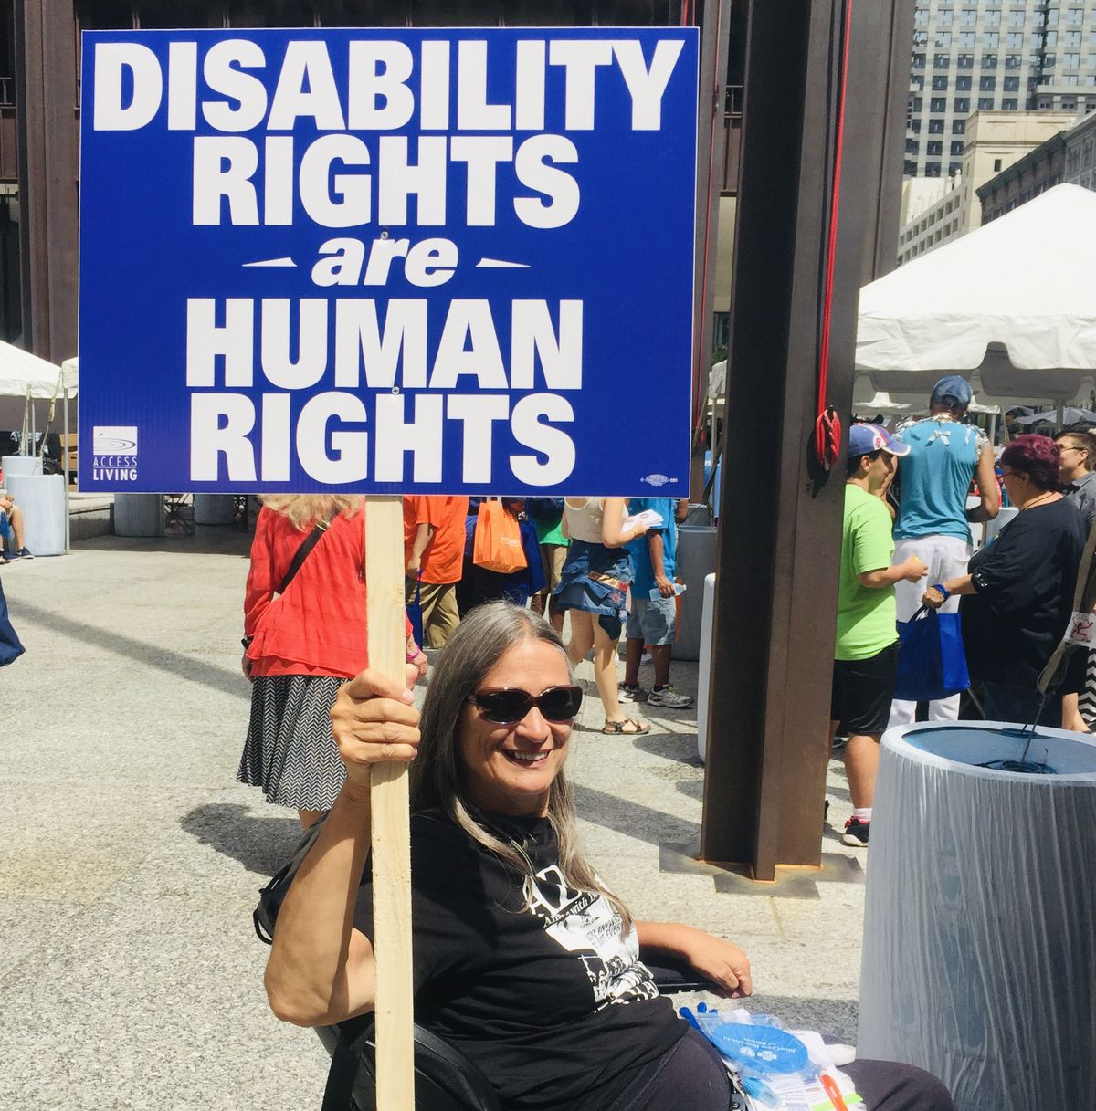
“The things we've been advocating are not just for a marginal group of people; they're for the
society as a whole.
Disability affects all of us.
It's time that we normalize and accept it rather than perceive it to be at the margins of our society."
- Marca Bristo

